Slide 1
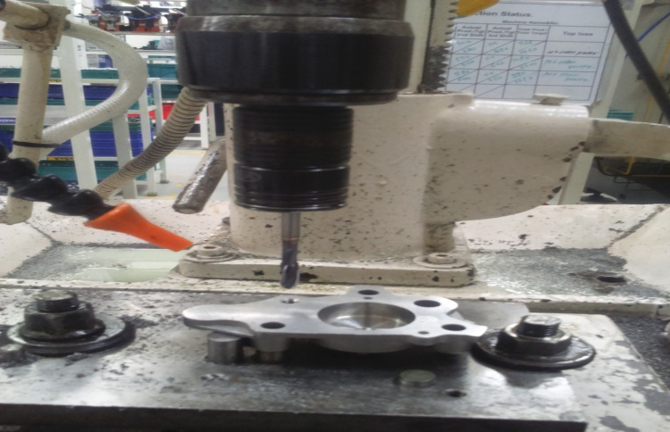
AHPL/QMS/FR/09/E
TPM CIRCLE NO :-
ACTIVITY
KK
QM
PM
JH
SHE
OT
DM
E&T
KAIZEN IDEA SHEET
TPM CIRCLE NAME:
LOSS NO. / STEP
DEPT :-
RESULT AREA
P
Q
A
C
D
S
M
CELL:- Oil Pump
CELL NAME :- A499 Body
MACHINE / STAGE :- Machining
OPERATION :- M6 Tapping
KAIZEN THEME : To Reduce Extra Set Up.
IDEA :- Operation Split
Problem present status :- A499 Body Cover Separate Machining due to Tool Magazine Capacity Less.
COUNTERMEASURE:- M6 Tapping Operation Split On Portable Tapping Machine.
BENCHMARK
Separate machining
TARGET
Combine machining
KAIZEN START
10.05.2017
TDC
12.05.2017
KAIZEN FINISH
12.05.2017
TEAM MEMBERS : Umesh Pimple ,
Dnyaneshwar Pawar, Sachin Chaudhari,
Atul Kadam
BENEFITS :-
Body & Cover Combine Machining in Set.
Before
After
KAIZEN SUSTENANCE
WHY - WHY ANALYSIS :-
Why1 :- Separate Machining A499 Body & Cover.
Why2:- All Tools required for Body & Cover Machining not arrange in Magazine.
Why3 :- Magazine Tool Capacity Les (14nos).
Why4 :- Machine Design Standard with 14 tools.
RESULT :-
1) Body & Cover Combine Machining in Set.
2) Manpower Save due to Separate Machining.
WHAT TO DO:- Process not to Change.
HOW TO DO:- Process to be Change in PFC
FREQUENCY :- 1 Time
ROOT CAUSE :- Machine Design Standard with 14 tools
REGISTRATION NO. & DATE : 12.05.2017
SCOPE & PLAN FOR HORIZONTAL DEPLOYMENT
REGISTERED BY :- Umesh Pimple
SR.
NO.
CELL
TARGET
RESPONSIBILITY
STATUS
MANAGER’S SIGN :- Dnyaneshwar Pawar
Nil
Rev. No.:01, Rev. Date:15.12.2016

